Slide 1

Design is life
By Anastasiya Zorina and Timakova Lidiya

Slide 2
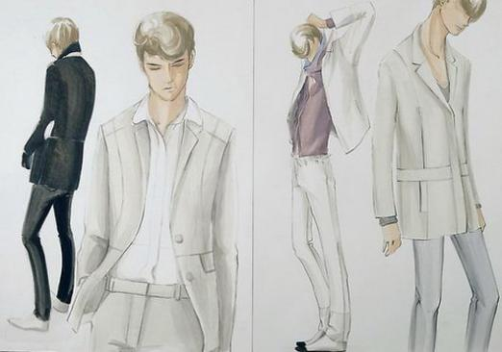
What is the design?
Design is the activity of the aesthetic properties of industrial products. It consists of several categories:
* Fashion Design
*Interior Design
* Furniture design, etc.

Slide 3
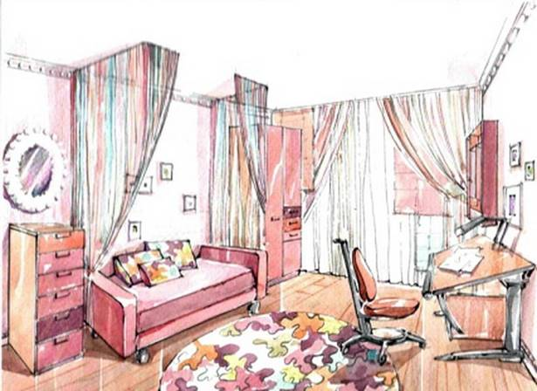
Interior Design.
Design is a specific kind of project activity, united together art-subject creativity and science-based engineering practice in the field of industrial production.

Slide 4

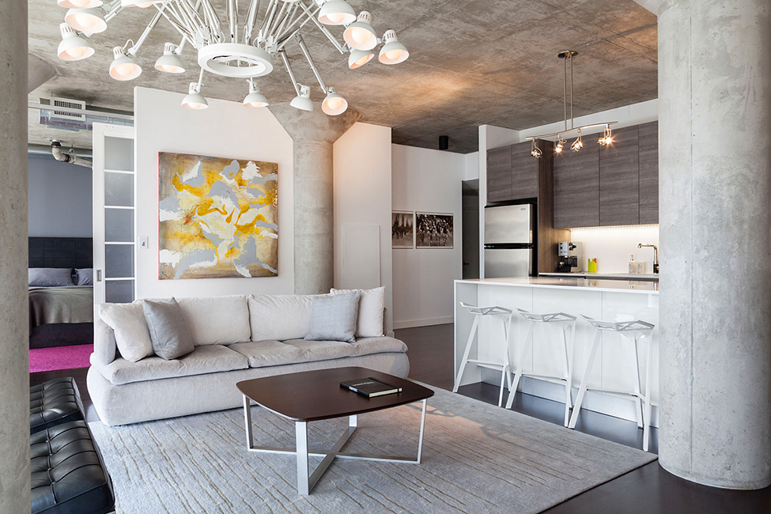
How to become a designer?
Let's talk about how to become a designer, how to start. The profession of a designer has always been considered fashionable and has not lost its relevance today
To be a designer it’s necessary to develop your taste and painting ability . The perfect helper is the art school.

Slide 5

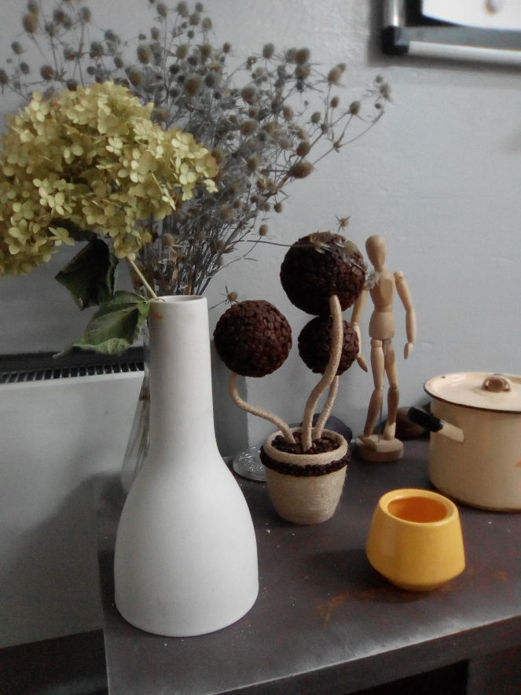
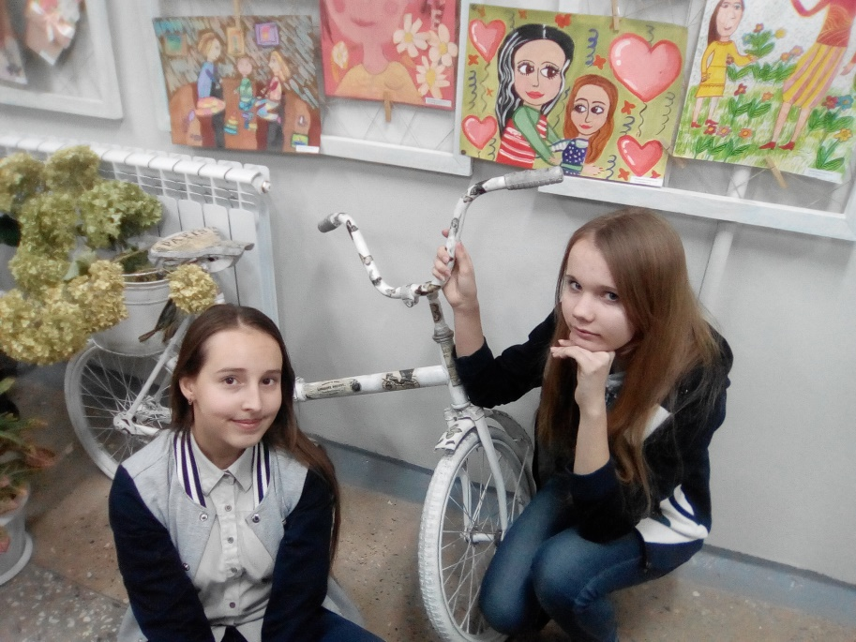
We go to the art school. There we are taught design. In these lessons we make a lot of things .Theseiilessona are very exciting.

Slide 6
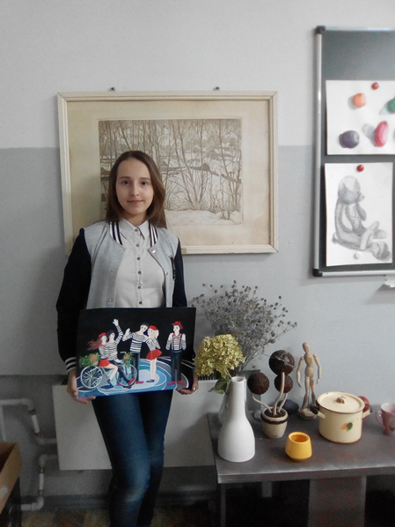
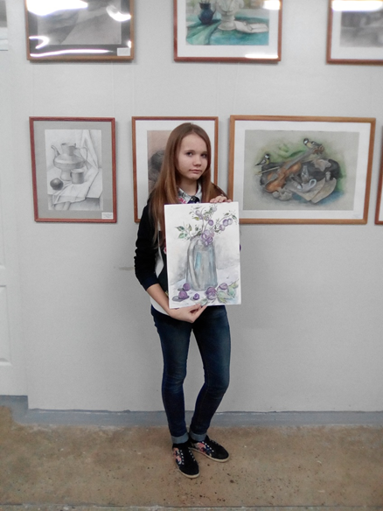
But in art school we are taught not only the design. We are studying art history, painting and textiles

Slide 7
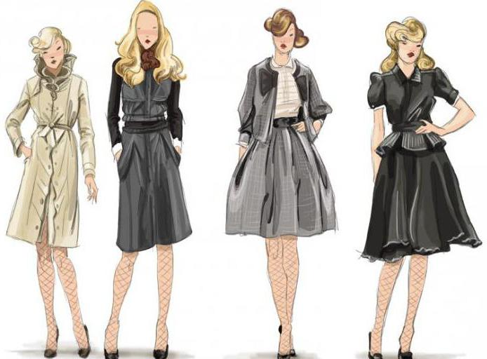
The representatives of this profession can be considered the real "fashion genius". They have to invent the whole conception of the new collection, develop individual projects, offering the original technology.

Slide 8
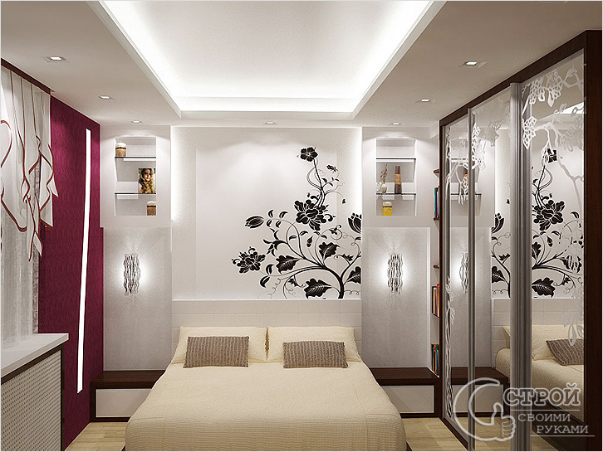
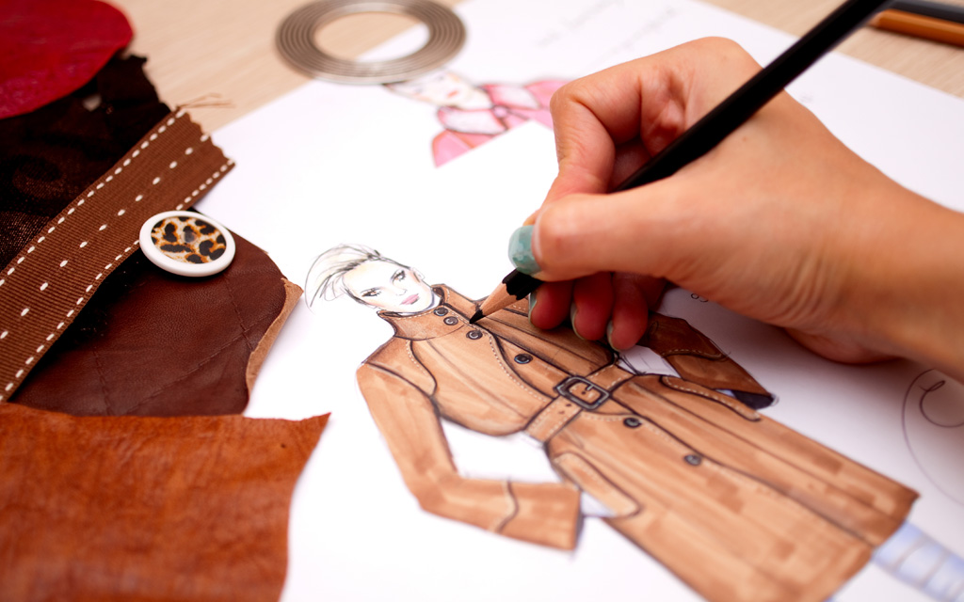
Design is a very exciting passion, opening a huge number of possibilities.

Slide 9
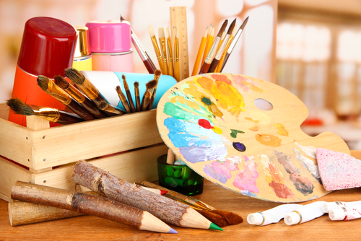
Thank you for watching

